Slide 1

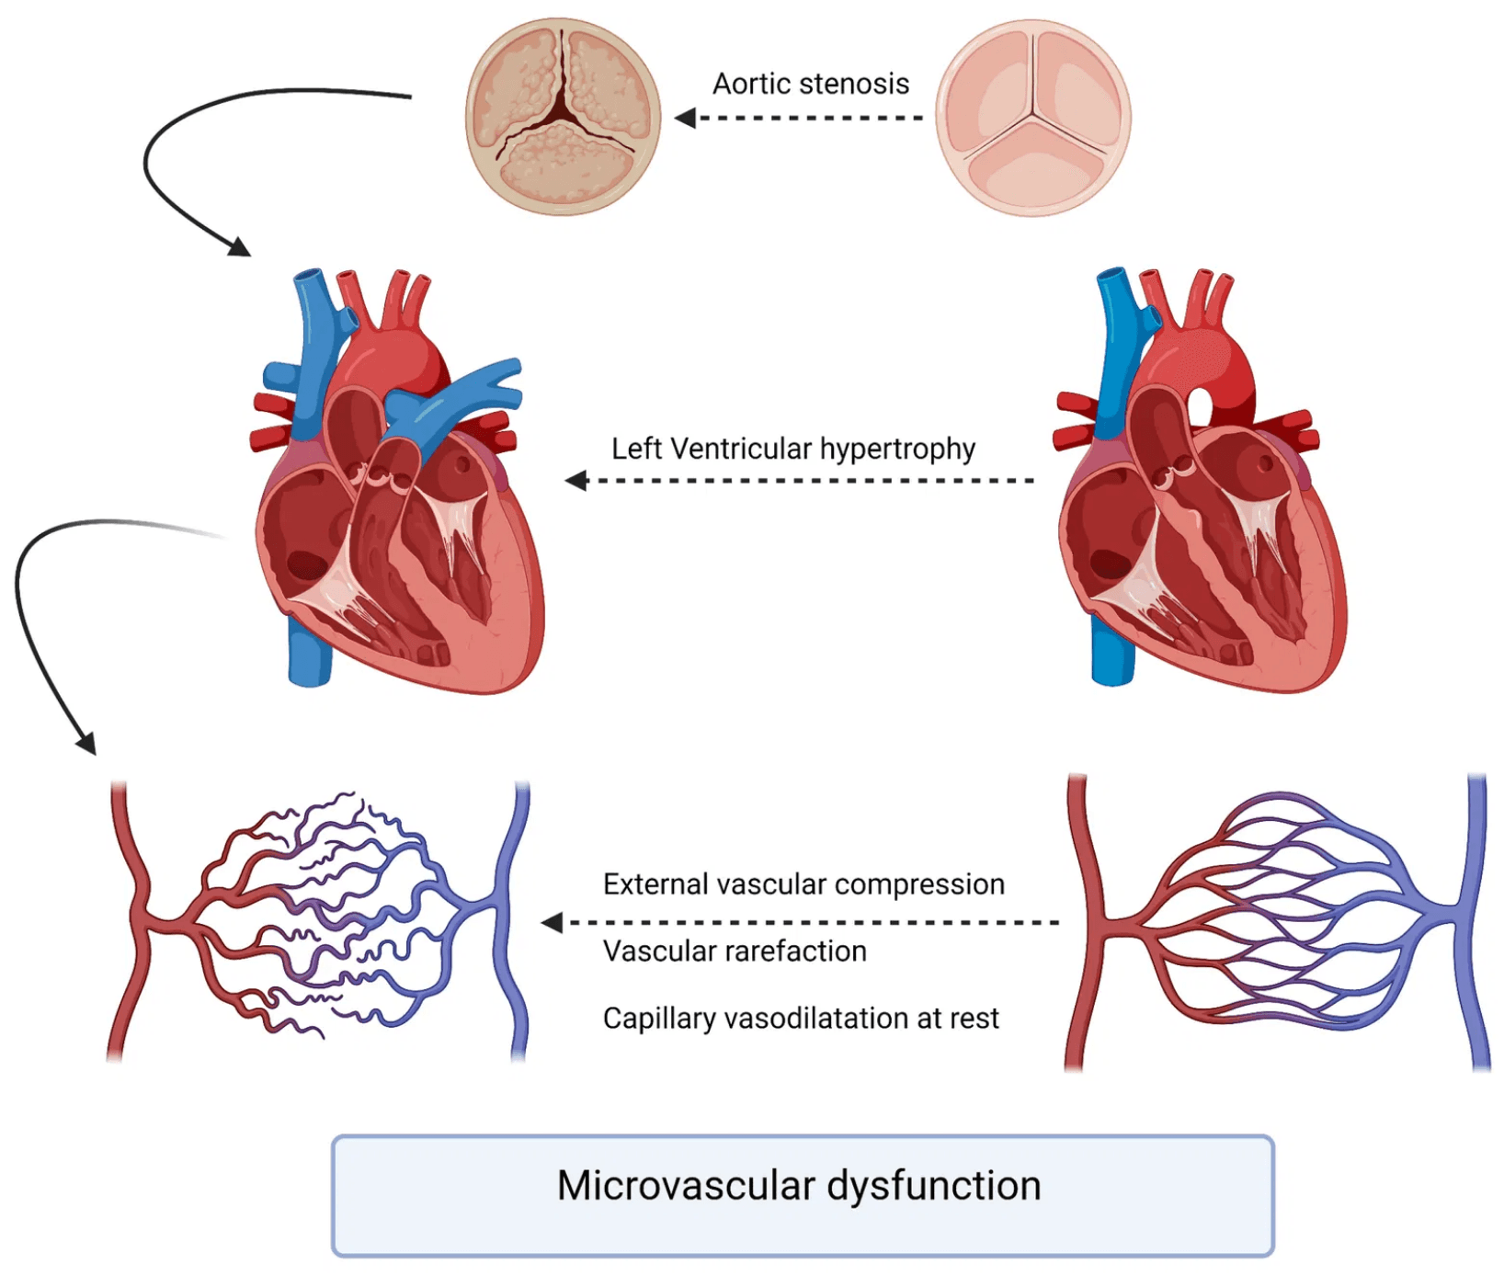
DFM-EUROPE × ELCS RESEARCH CONSORTIUM
Generative Adversarial Framework for Patient-Specific Adjustment of Fractional Flow Reserve
Scientific Context: Advanced AI models for non-invasive physiological assessment of coronary artery disease through computational fluid dynamics, deep learning, and clinical data fusion
FFR
Conditional GAN
CNN
Multicentric AI
Precision Medicine
Coronary Physiology
Computational Hemodynamics

Slide 2

Patient-Specific FFR Refinement Through Conditional GAN Architecture
The Challenge
Research Context
Why Conditional GAN?
Current baseline CNN models for FFR estimation provide anatomical insights from coronary imaging but lack integration of patient-specific clinical and demographic factors that significantly influence coronary hemodynamics.
Consortium: DFM-EUROPE × ELCS RESEARCH scientific initiative
GANs enable the generation of physiologically plausible FFR adjustments by learning complex, non-linear relationships between clinical variables and hemodynamic outcomes.
Integration: Computational fluid dynamics, deep learning, and clinical data fusion
Focus: Non-invasive physiological assessment of coronary artery disease
Maintains consistency with the underlying physics of coronary blood flow while personalizing predictions
Models do not account for inter-patient variability and multicentric data heterogeneity
Gap: Age, sex, comorbidities, and site variability not modeled

Slide 3

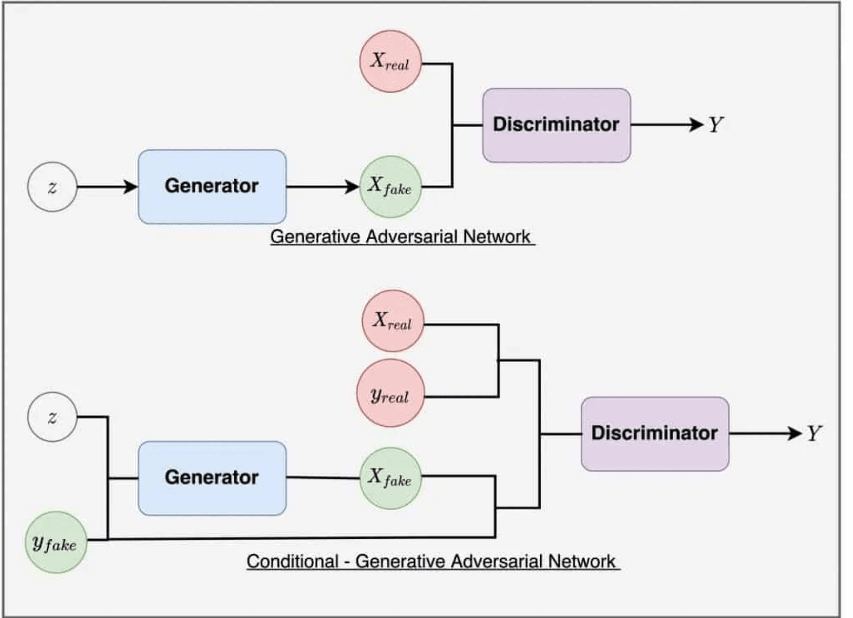
Conditional GAN Architecture: Generator and Discriminator Components
Generator (G)
Goal: Creates refined, patient-specific FFR values by adjusting the baseline CNN predictions using clinical and demographic data.
Input:
FFR-CNN baseline prediction + conditioning vector
Conditioning Variables:
Demographic: age, sex
Clinical comorbidities: diabetes, hypertension, obesity, prior CVD
Data origin: multicentric site identifier
Output:
Adjusted FFR value (patient-specific refinement)
Architecture:
Uses fully connected (dense) layers with residual connections to stabilize learning and preserve input information while refining outputs.
Discriminator (D)
Goal: Evaluates whether an FFR value (real or generated) is physiologically realistic for the given patient profile.
Input:
Adjusted FFR + conditioning vector OR Ground truth FFR + conditioning vector
Task:
Distinguish between generator-produced FFR and reference FFR measurements
Architecture:
Deep feedforward network with dropout for regularization to prevent overfitting

Slide 4

Training Strategy and Implementation Details
1. Loss Function
2. Data
3. Validation
Multi-component objective combining:
Multicentric coronary imaging datasets with invasive FFR as ground truth
Cross-center validation approach to assess model generalizability
•
Adversarial loss:
Enables realistic FFR generation through generator-discriminator competition
Data Split Strategy:
•
Test on held-out clinical centers not seen during training
•
70% training set
•
L1 reconstruction loss:
•
15% validation set
•
Evaluate performance across different patient populations
Maintains proximity to baseline FFR-CNN predictions
•
15% test set
•
Physiological constraint loss:
•
Assess robustness to inter-site variability and imaging protocols
Stratified by center to ensure balanced representation
Enforces domain-informed boundaries (FFR ∈ [0,1], hemodynamic plausibility)
Framework Implementation
Hyperparameter Tuning
PyTorch or TensorFlow for conditional GAN architecture with iterative generator-discriminator optimization
Learning rate, batch size, loss function weights, and network depth optimized through systematic grid search

Slide 5

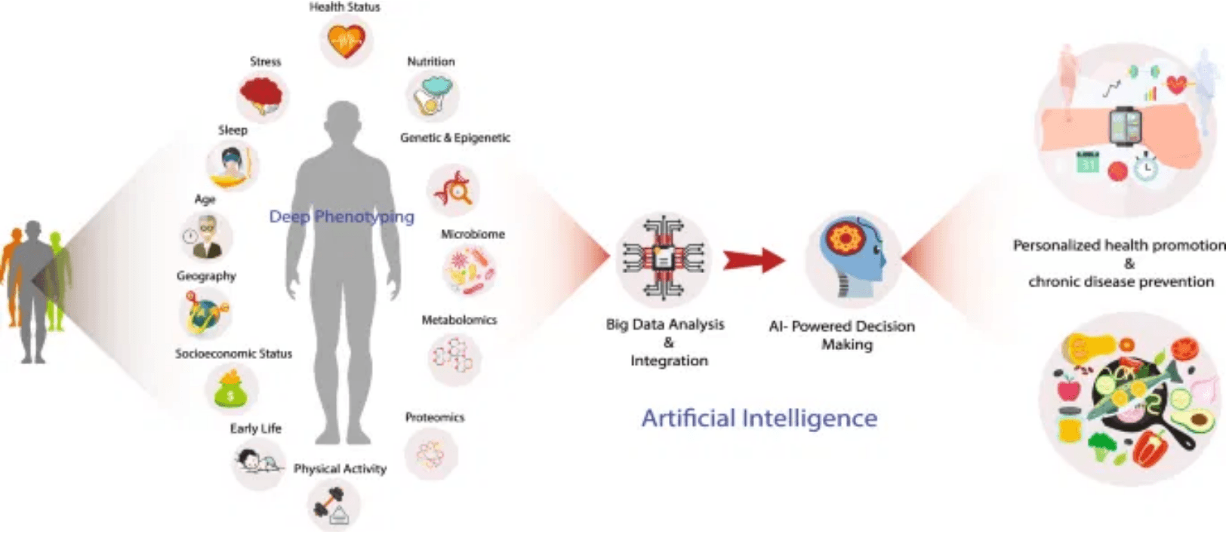
Enhanced Physiological Plausibility and Precision Cardiology
1
Patient-Specific FFR Adjustment Model
Refined FFR predictions accounting for individual clinical profiles
Quantified contribution of each conditioning variable (age, sex, diabetes, etc.)
Improved alignment with invasive FFR measurements across diverse populations
2
Multicentric Variability Analysis
Identification and quantification of inter-site differences in FFR estimation
Data harmonization framework to reduce center-specific bias
Clinical Relevance
Enhanced model robustness for deployment across different clinical centers
→ More reliable non-invasive FFR estimation reducing unnecessary invasive catheterization
3
Reproducible AI Framework
→ Personalized risk stratification for coronary artery disease management
Open-source implementation integrating data-driven learning with domain knowledge
Modular architecture allowing incorporation of additional clinical variables
→ Foundation for future AI-driven hemodynamic assessment tools
Contribution to consortium's broader AI-based precision cardiology initiative

